Slide 1

IBM Applied Data Science Capstone Richmond, VA Supermarket Study
Randy Michaud

Slide 2

Richmond, Virginia
Incorporated 1742; Established as a city in 1871
Population: Richmond ~ 227,000, Metro area ~1.2 million people

Slide 3
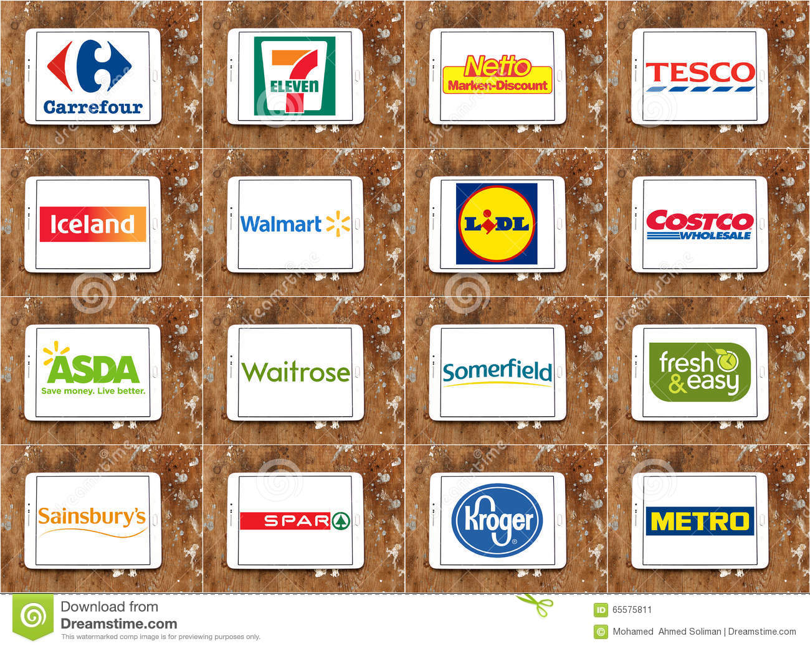
Opportunity:
Explore the Richmond, Virginia metro area for a potential new supermarket to serve an area of Richmond that currently lacks that grocery option.

Slide 4
Analysis and Modeling
Data from Richmond, Virginia city data portal, Wikipedia, and Foursquare were utilized
Data was wrangled – cleaned, merged, evaluated
Information was visualized into maps
Statistical analysis – Kmeans – utilized to cluster
Cluster mapping and evaluation

Slide 5
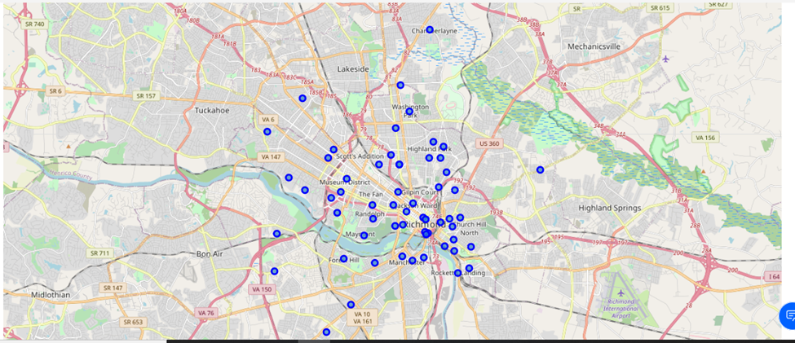
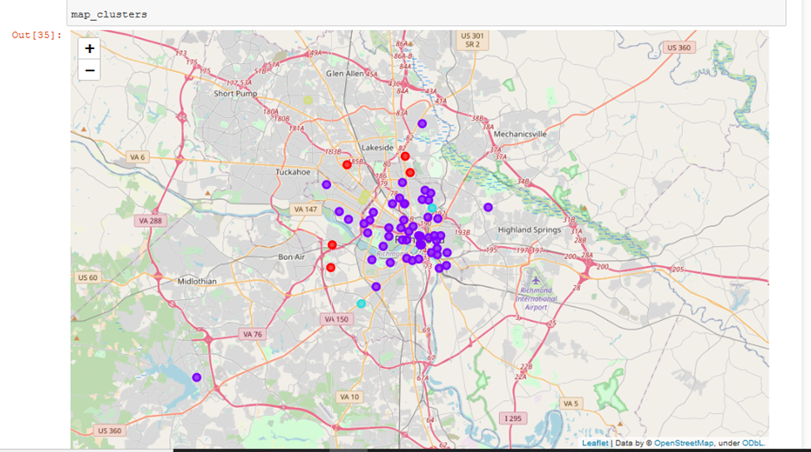
Examples of Data Visualization:
Top - Neighborhood mapping for the Richmond, Virginia metro area
Bottom – Clustered data of venue information from Foursquare for the Richmond, Virginia metro area

Slide 6
Conclusions
Upon completing the data science exercise and analysis:
When segmented into clusters, three of the clusters showed that areas are being served by large chain supermarkets.
A single cluster, mostly comprised of the inner city neighborhoods, showed a lack of supermarkets as a grocery option for that area.
This single cluster represents opportunity for a supermarket company to enter the inner city neighborhoods of Richmond, Virginia to offer residents and businesses that grocery option.
Next Step – The density of inner city neighborhoods could present a challenge to establishing a large supermarket within that cluster. While most of these areas may be served by smaller markets and grocery stores, a real estate study would be the next step to identify a location that could accommodate a large supermarket to serve this area.

